Slide 1

Turing Machines
Sections 17.3 – 17.5

Slide 2
Turing Machine Extensions
There are many extensions we might like to make to our basic Turing machine model. But:
We can show that every extended machine
has the same power as the basic machine.
Some possible extensions:
Multiple tape TMs
Nondeterministic TMs

Slide 3
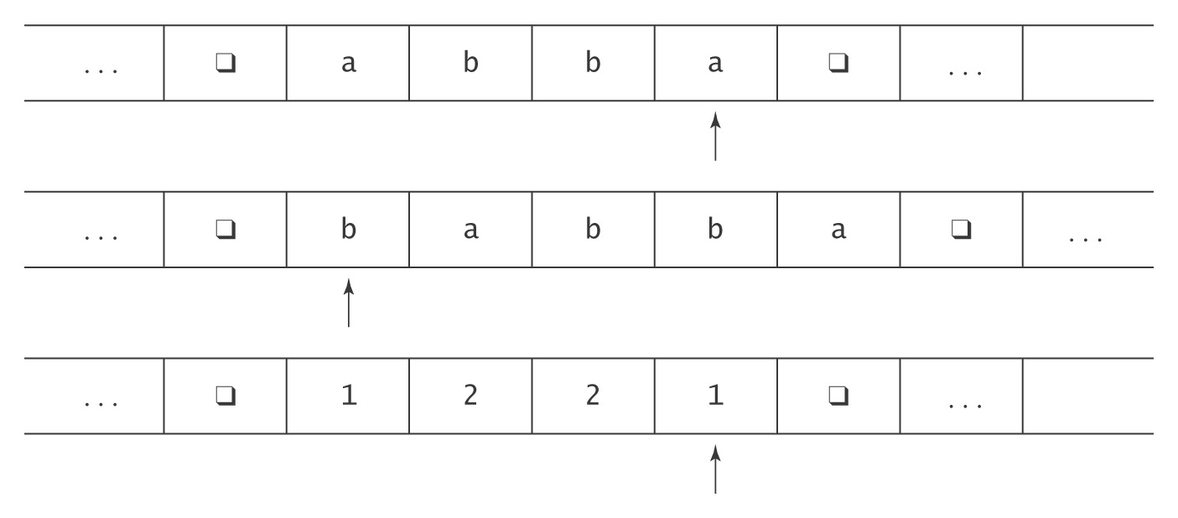
Multiple Tapes

Slide 4
Multiple Tapes
The transition function for a k-tape Turing machine:
  ((K-H) , Γ₁ to (K , Γ_{1′}, {←, →, ↑}
  , Γ₂ , Γ_{2′}, {←, →, ↑}
  , . , .
  , . , .
  , Γ_{k}) , Γ_{k′}, {←, →, ↑})
  Input: as before on tape 1, others blank.
  Output: as before on tape 1, others ignored.
  Note: tape head is allowed to stay put.

Slide 5
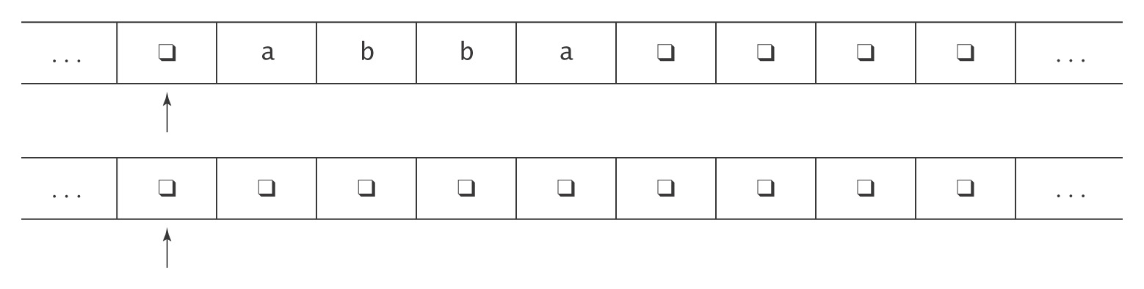
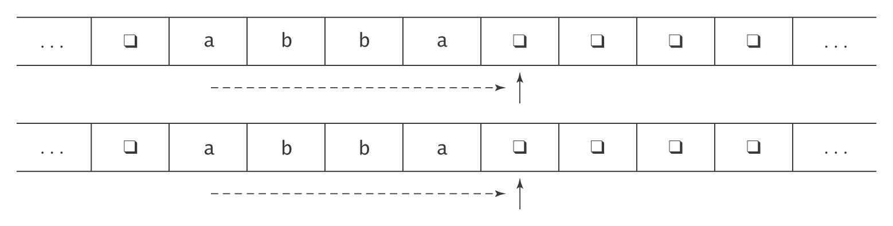
Example: Copying a String

Slide 6
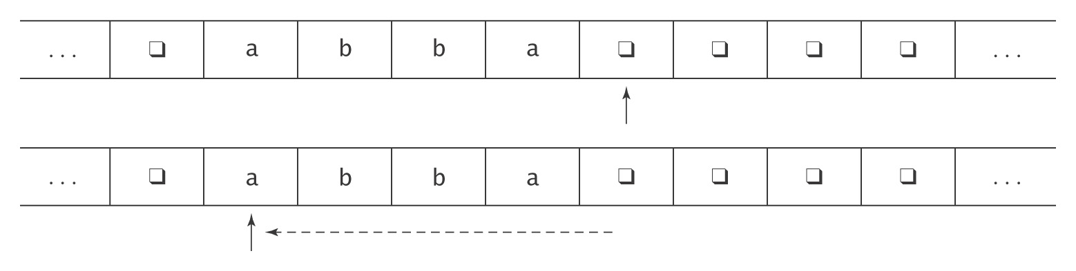
Example: Copying a String

Slide 7
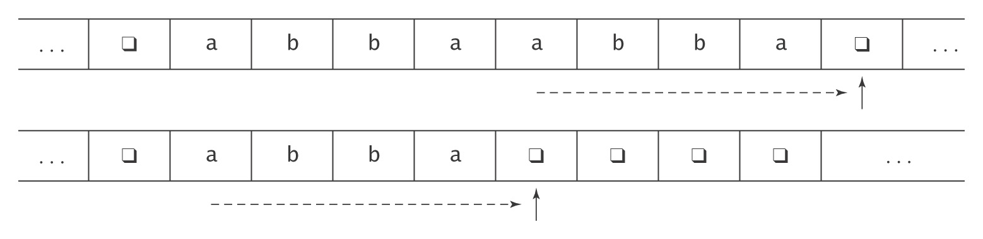
Example: Copying a String

Slide 8
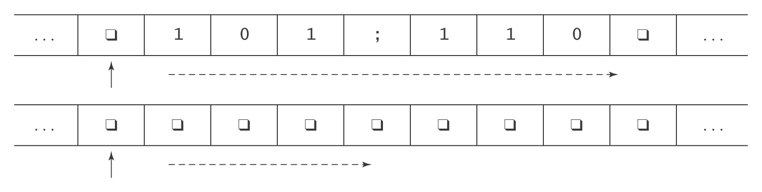
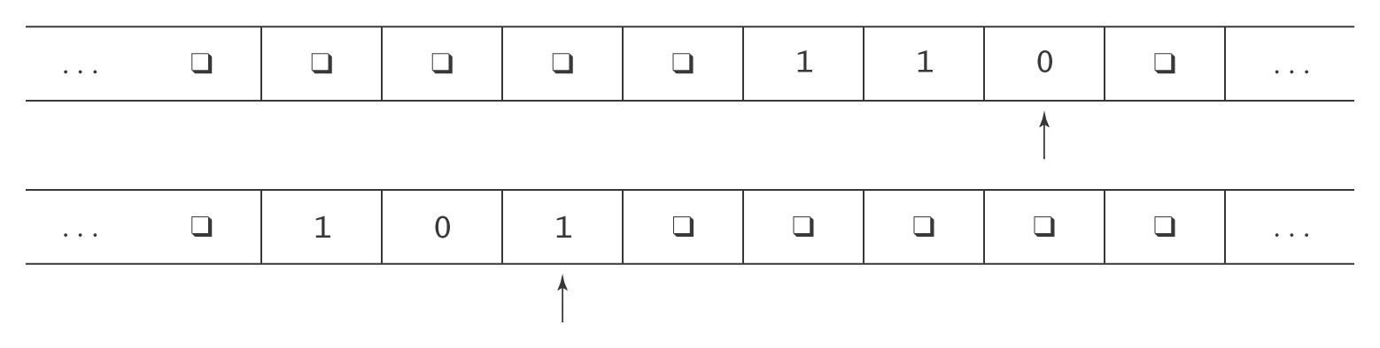
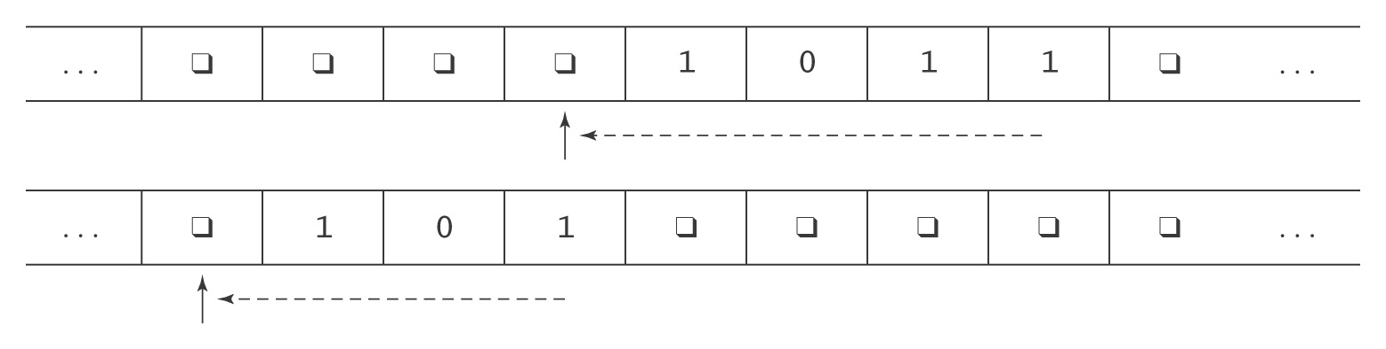
Another Two Tape Example: Addition

Slide 9
Adding Tapes Adds No Power
Theorem: Let M be a k-tape Turing machine for some k ≥ 1. Then there is a standard TM M' where Σ ⊆ Σ', and:
● On input x, M halts with output z on the first tape iff
M' halts in the same state with z on its tape.
● On input x, if M halts in n steps, M' halts in O(n²) steps.
Proof: By construction.

Slide 10
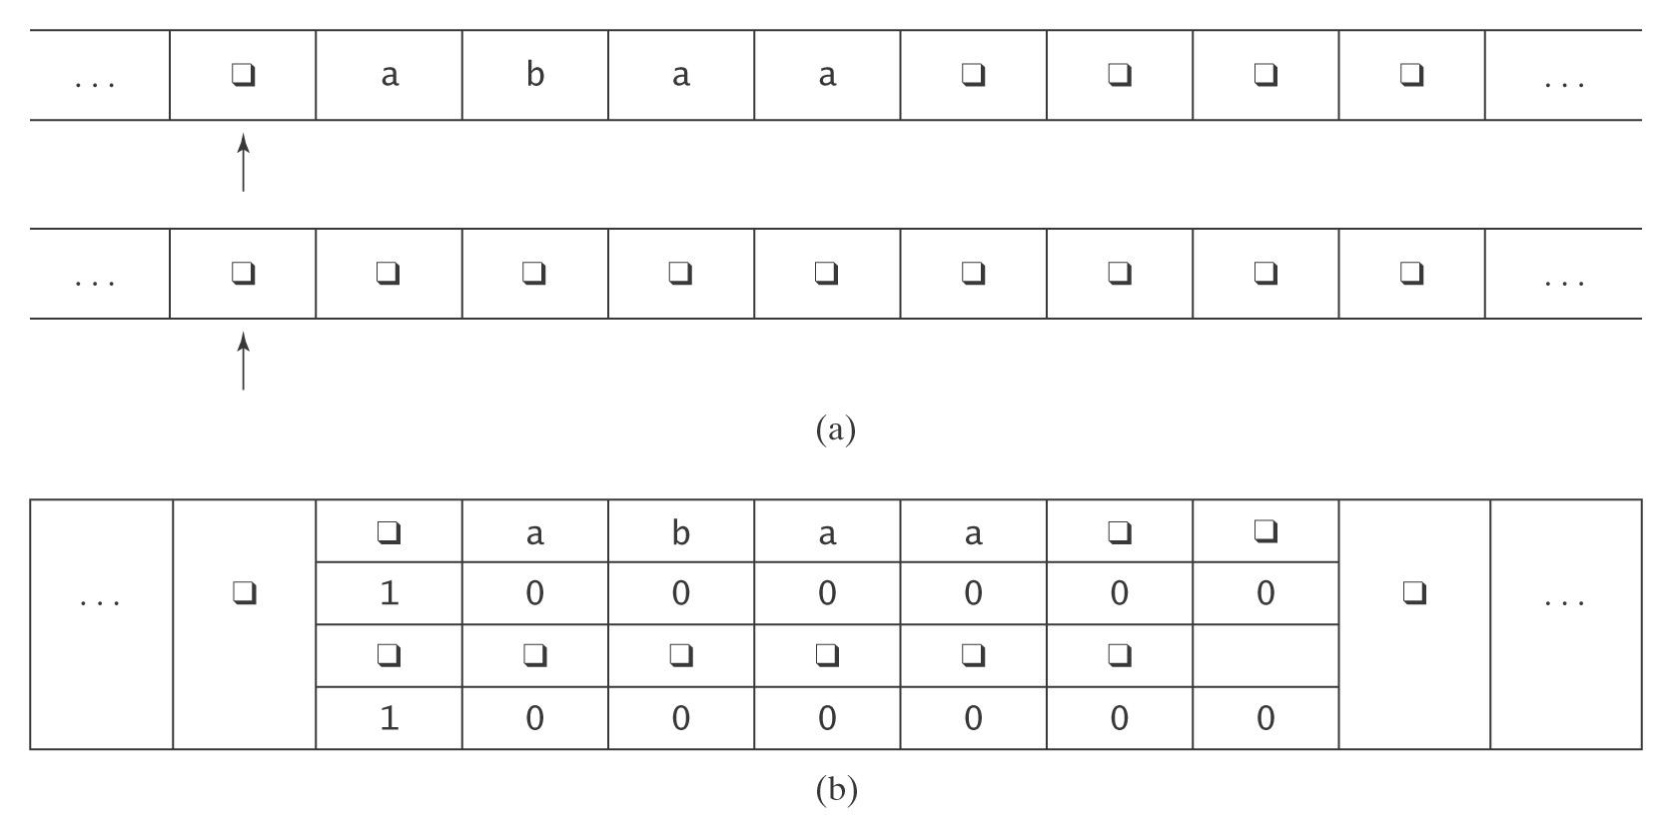
The Representation
Alphabet (Σ') of M' = Γ ∪ (Γ × {0, 1})^{k}:
, a, b, (, 1, , 1), (a, 0,  ,0), (b, 0, , 0), …

Slide 11
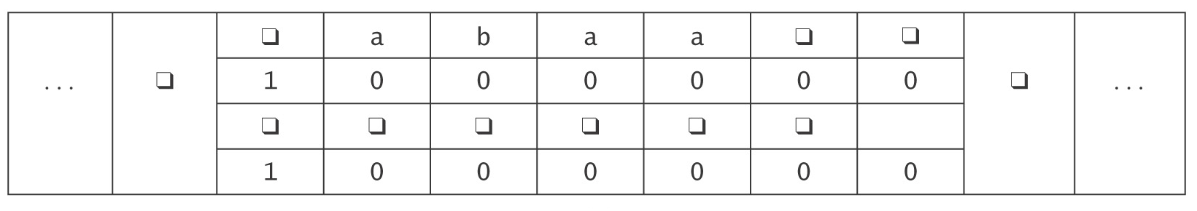
The Operation of M'
1. Set up the multitrack tape.
2. Simulate the computation of M until (if) M would halt:
  2.1 Scan left and store in the state the k-tuple of characters
  under the read heads. Move back right.
  2.2 Scan left and update each track as required by the
  transitions of M. If necessary, subdivide a new square into
  tracks. Move back right.
3. When M would halt, reformat the tape to throw away all but track 1,
position the head correctly, then go to M’s halt state.

Slide 12
How Many Steps Does M' Take?
Let: w be the input string, and
n be the number of steps it takes M to execute.
Step 1 (initialization): O(|w|).
Step 2 ( computation):
Number of passes = n.
Work at each pass: 2.1 = 2 ⋅ (length of tape).
= 2 ⋅ (|w| + n).
2.2 = 2 ⋅ (|w| + n).
Total: O(n ⋅ (|w| + n)).
Step 3 (clean up): O(length of tape).
Total: O(n ⋅ (|w| + n)).
= O(n²). *
* assuming that n ≥ w

Slide 13
Impact of Nondeterminism
● FSMs
  ● Power NO
● PDAs
  ● Power YES
● Turing machines
  ● Power NO

Slide 14
Nondeterministic Turing Machines
A nondeterministic TM is a sixtuple (K, Σ, Γ, Δ, s, H).
Δ is a subset of:
((K - H) × Γ) × (K × Γ × {←, →})

Slide 15
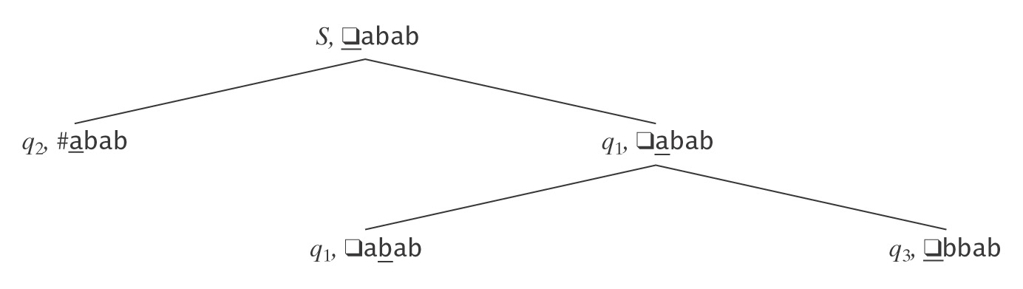
Nondeterministic Turing Machines
What does it mean for a nondeterministic Turing machine to:
● Decide a language
● Semidecide a language
● Compute a function

Slide 16
Nondeterministic Deciding
Let M = (K, Σ, Γ, Δ, s, {y, n}) be a nondeterministic TM.
Let w be an element of Σ*.
M accepts w iff at least one of its computations accepts.
M rejects w iff all of its computations reject.
M decides a language L ⊆ Σ* iff, ∀w:
● There is a finite number of paths that M can follow on input w,
● All of those paths halt, and
● w ∈ L iff M accepts w.

Slide 17
An Example of Nondeterministic Deciding
L = {w ∈ {0, 1}* : w is the binary encoding of a composite number}.
M decides L by doing the following on input w:
1. Nondeterministically choose two positive binary numbers such that:
2 ≤ |p| and |q| ≤ |w|.
Write them on the tape, after w, separated by ;
110011;111;1111
2. Multiply p and q and put the answer, A, on the tape, in place of p
and q.
110011;1011111
3. Compare A and w. If equal, go to y. Else go to n.

Slide 18
Nondeterministic Semideciding
Let M = (K, Σ, Γ, Δ, s, H) be a nondeterministic TM.
We say that M semidecides a language L ⊆ Σ* iff:
for all w ∈ Σ*:
w ∈ L iff
(s, w) yields a least one accepting configuration.

Slide 19
An Example
L = {w ∈ {a, b, c, d}* : there are two of at least one letter}
¬a/→
2
a/→ ¬b/→ a
0 /→ 1 b/→ 3 b y
∀/→ c/→ ¬c/→ c
d/→ 4
¬d/→ d
5
But, in this case, we can do better.

Slide 20
A Harder Example
Let L = {descriptions of TMs that halt on at least one string}.
Let <M> mean the string that describes some TM M.
S semidecides L as follows on input <M>:
1. Nondeterministically choose a string w in Σ_{M}* and write it on
the tape.
2. Run M on w.
We’ll prove later that, in this case, semideciding is the best we can do.

Slide 21
Nondeterministic Function Computation
M computes a function f iff, ∀w ∈ Σ* :
● All of M’s computations halt, and
● All of M’s computations result in f(w).

Slide 22
Equivalence of Deterministic and Nondeterministic Turing Machines
Theorem: If a nondeterministic TM M decides or semidecides a language, or computes a function, then there is a standard (deterministic) TM M’ deciding or semideciding the same language or computing the same function.
Proof: (by construction). We must do separate constructions for deciding/semideciding and for function computation.

Slide 23
For Deciding/Semideciding
Build M', which tries the possible computations of M. If one of them accepts, M' accepts.

Slide 24
For Deciding/Semideciding
Recall the way we did this for FSMs: simulate being in a combination of states.
Will this work here?

Slide 25
For Deciding/Semideciding
What about: Try path 1. If it accepts, accept. Else
Try path 2. If it accepts, accept. Else
•
•

Slide 26
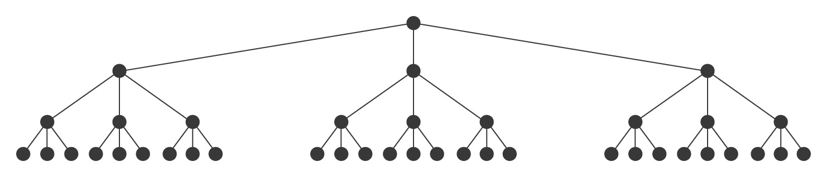
Iterative Deepening
Iterative deepening:
1. d = 1 /* set the initial depth limit to 1 */
2. Loop until a solution is found
  2.1 Start at the root node; explore all paths of depth d,
  depth first.
  2.2 If a solution is found, exit.
  2.3 d = d + 1.

Slide 27
Restart Iterative Deepening
Start over at the root each time.

Slide 28
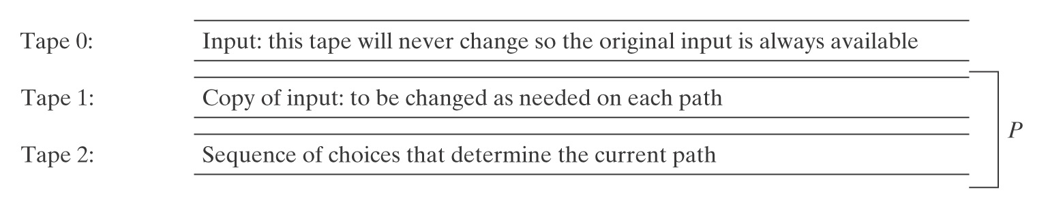
M′ Uses Three Tapes

Slide 29
If M is a Deciding Machine
M′ should halt as soon as one of the following things happens:
● It discovers a path along which M halts and accepts. In this case,
M′ accepts.
● It has tried all paths until they halt, but all have rejected. In this
case, M′ rejects.

Slide 30
Simulating a Real Computer
● An unbounded number of memory cells addressed by the integers starting
at 0.
● An instruction set composed of basic operations including load, store, add,
subtract, jump, conditional jump, and halt. Here’s a simple example program:
R 10 read 2 bits from tape into accumulator
MIR 10 move input pointer 2 bits right
CJUMP 1001 conditional jump; if acc = 0, go to 1001
A 10111 add location 10111 value to accumulator
ST 10111 store result at location 10111
● A program counter.
● An address register.
● An accumulator.
● A small fixed number of special purpose registers.
● An input file.
● An output file.

Slide 31
Simulating a Real Computer
Theorem: A random-access, stored program computer can be simulated by a Turing Machine.
Proof: By construction.
simcomputer will use 7 tapes:
● Tape 1: the computer’s memory.
● Tape 2: the program counter.
● Tape 3: the address register.
● Tape 4: the accumulator.
● Tape 5: the op code of the current instruction.
● Tape 6: the input file.
● Tape 7: the output file, initially blank.

Slide 32
Representing Memory
Memory will be organized as a series of (address, value) pairs, separated by delimiters:
#0,val₀#1,val₁#10,val₂#11,val₃#100,val₄# …#
Instructions: four bit operation code followed by address. So our example program could look like:
#0,000110010#1,11111001#10,001110011#
11,001010111#....
Must delimit words because no bound on their length:
● Addresses may get longer as the simulated program uses
more words of its memory.
● Numeric values may increase as old values are added to
produce new ones.

Slide 33
Simcomputer
simcomputer(program) =
1. Move the input string to tape 6.
2. Initialize the program counter (tape 2) to 0.
3. Loop:
  3.1 Starting at the left of the nonblank portion of tape 1, scan right
  looking for an index that matches the contents of tape 2 (the
  program counter).
/* Decode the current instruction and increment the program counter.
  3.2 Copy the operation code to tape 5.
  3.3 Copy the address to tape 3.
  3.4 Add 1 to the value on tape 2.
/* Retrieve the operand.
  3.5 Starting at the left again, scan right looking for the address
  stored on tape 3.
/* Execute the instruction.
3.6 If the operation is Load, copy the operand to tape 4.
  3.7 If the operation is Add, add the operand to the value on tape 4.
  3.8 If the operation is Jump, copy the value on tape 3 to tape 2
  3.9 And so forth for the other operations.

Slide 34
Alternative TM Definitions
An alternative definition of a Turing machine: one-way tape
◊ is a wall. The TM cannot move to the left past ◊.
So δ is constrained as follows:
(a) if the input symbol is ◊, the action is →, and
(b) ◊ can never be written.
◊  a b b a 

Slide 35
Does This Difference Matter?
Remember the goal:
Define a device that is:
● powerful enough to describe all computable things,
● simple enough that we can reason formally about it
Both definitions are simple enough to work with, although details may make specific arguments easier or harder.
But, do they differ in their power?
Answer: No.

Slide 36
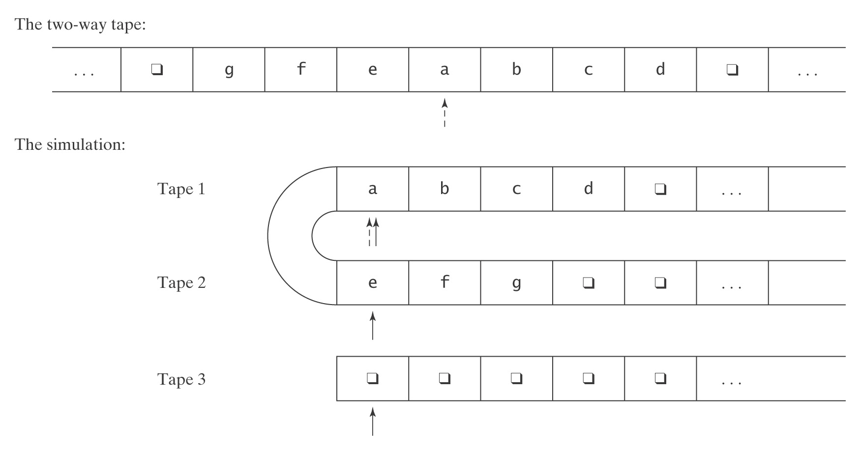
The Simulation

Slide 37
Stacks vs. a Tape
● Did we lose anything by giving up the PDA’s stack in
favor of the TM’s tape?
● Could we have gotten the power of a TM’s tape just with stacks?

Slide 38
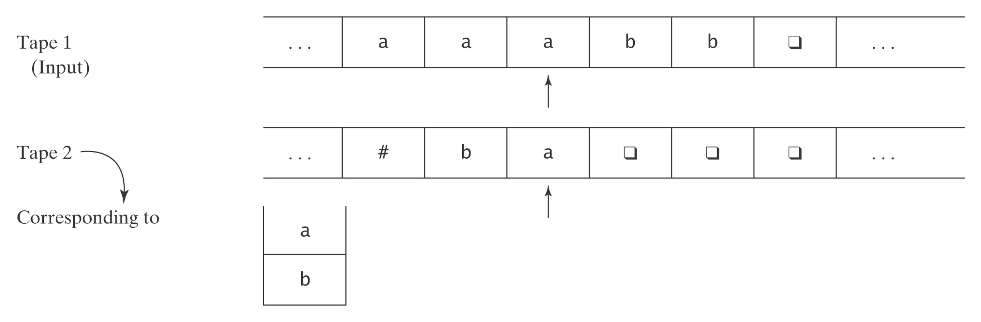
Simulating a PDA
The components of a PDA:
● Finite state controller
● Input stream
● Stack

Slide 39
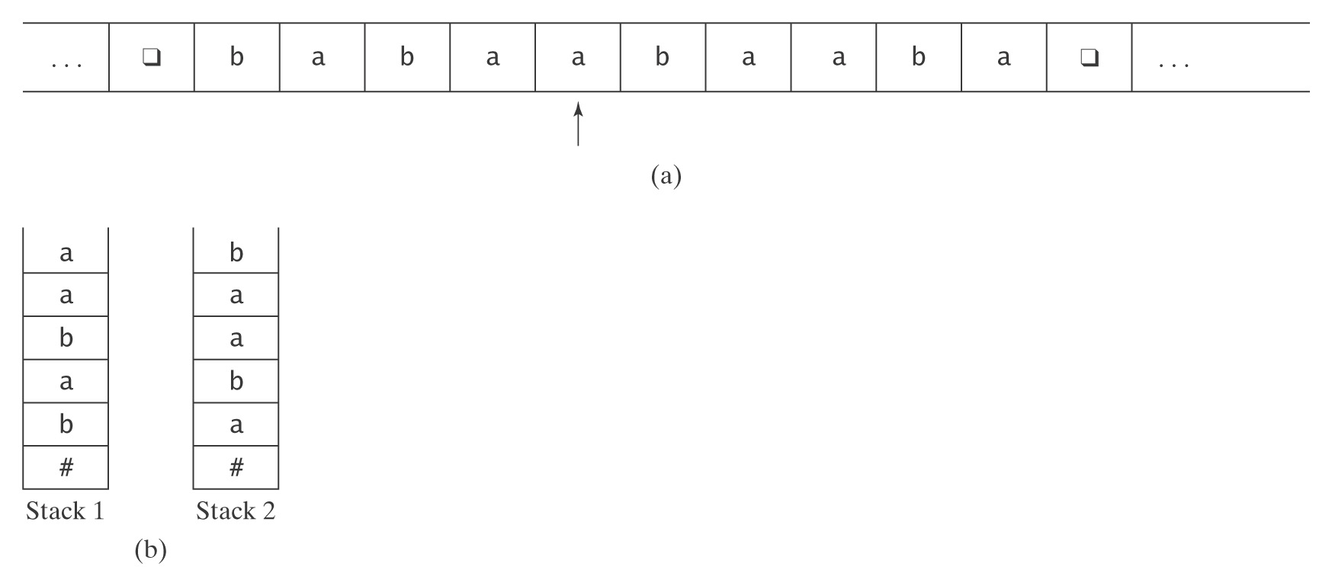
Simulating a Turing Machine with
a PDA with Two Stacks

